Slide 1

Predicting Ames, IA Housing Prices
Group: Glengarry Glen Ross
Liam McDermott
Jan Ruffner
David Wasserman
Ethan Zien
Notes:
Template acquired from http://www.free-powerpoint-templates-design.com

Slide 2
Agenda
01
Setting the Stage
02
Feature Analysis and Selection
03
Model Methodology
04
Results & Conclusion

Slide 3

Objective: Deliver a model to describe housing market in Ames, IA

Slide 4

Only US City with a population greater than 65,000 that has
45% of residents enrolled in college or graduate school
Notes:
Population 66,000, Median household income $46,000, homeownership rate is 40.8%.
Very high poverty rate at 28%
Ames, Iowa, is the only U.S. city with a population of at least 65,000 where more than 45% of residents are enrolled in college or graduate school
Ames is home to Iowa State University of Science and Technology, a leading institution in research related to Agriculture, Engineering, Design, and Veterinary Medicine.
Ames is in Story County and is one of the best places to live in Iowa. Living in Ames offers residents an urban suburban mix feel and most residents rent their homes. In Ames there are a lot of bars, coffee shops, and parks. Many young professionals live in Ames and residents tend to lean conservative

Slide 5
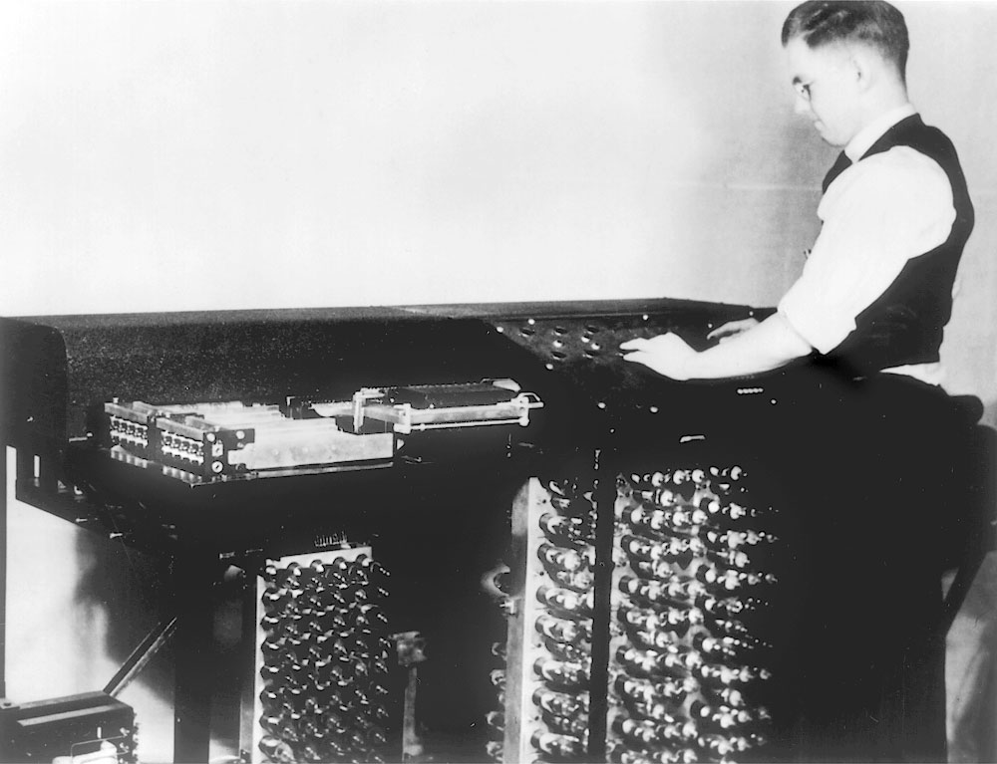
The Atanasoff–Berry Computer (ABC)
First Automatic Electronic Computer
Successfully tested 1942 - Iowa State College
Notes:
The Atanasoff–Berry computer (ABC) was the first automatic electronic digital computer.
Conceived in 1937, the machine was built by Iowa State College mathematics and physics professor John Vincent Atanasoff with the help of graduate student Clifford Berry.
It was designed only to solve systems of linear equations and was successfully tested in 1942

Slide 6
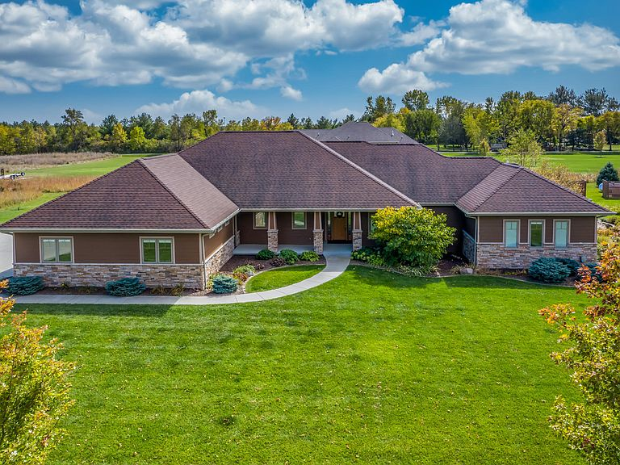
Green Hill : $198.65 Per Square Foot
Notes:
The market in Ames has a large range per square foot:

Slide 7
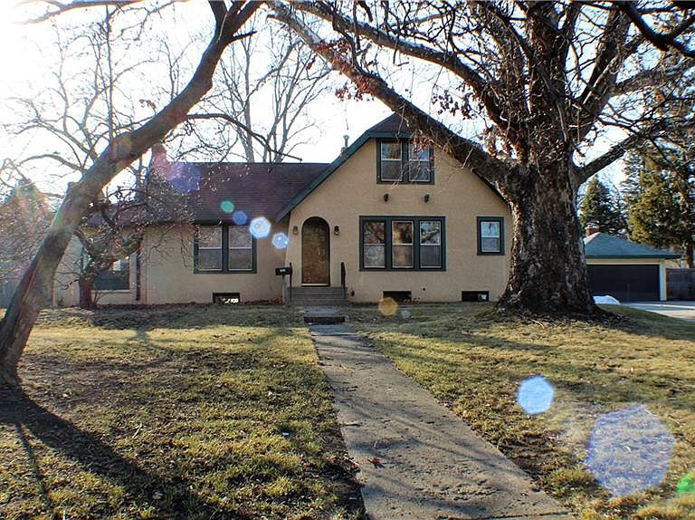
South West of ISU : $89.89 per square foot
Notes:
Home pictured is listed at just under $200K
Individual houses ranged from $30 to $275sq ft
Problem with per square foot :exact same home on one acers, will sell for more if it has 5 acres
A new home generally costs more. And a
large house may cost more overall because of higher labor costs and total construction costs
If house is overbuilt for the area, may actually sell for less than you might expect, based on its size

Slide 8
Model Preparation (Data Cleaning)
Removed duplicate records from the training set
Imputed zero (0) for numerical variables where NA (except Year )
Imputed None for categorical variables where NA
Notes:
# Impute NAs with None (Qualitative Variable)
Imputed None for categorical variables where NA
All basement replaced by none:No Basement Variables (BsmtQual/BsmtCond/BsmtExposure/BsmtFinType1/BsmtFinType2)
No Garage Variables (GarageType/GarageFinish/GarageQual/GarageCond)
MiscFeature missing (Shed Yes/No / Second Garage)
housing['BsmtQual'].fillna('None', inplace=True)

Slide 9
Feature Analysis & Selection

Slide 10
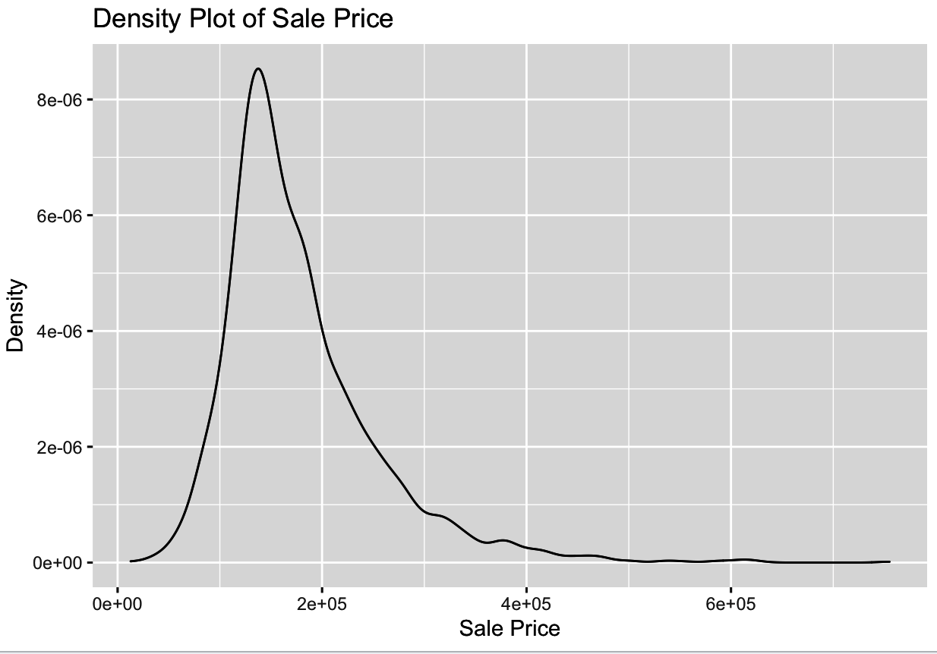
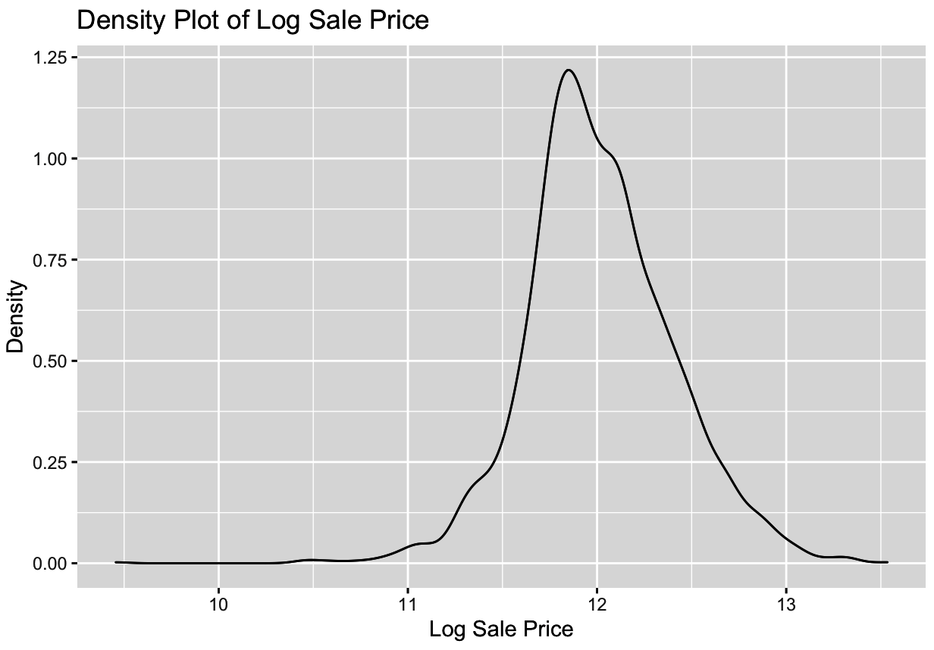
Chose to analyze log sale price to due to having a more normal distribution
Dependent Variable
Notes:
Had to look at how we wanted to analyze sale price. Looked at the actual sale price, cost/sq ft and log of sale price. Chose log of the sale price as it provided a more normal distirubtion

Slide 11
Feature Creation
Feature | Code Name | Calculation
Total Living Area | TotalLivingArea | GrLivArea + TotalBsmttSF - BsmtUnSF
Unused Lot Size | UnusedLotSize | LotArea - 1stFlrSF
Has Pool | HasPool | PoolArea > 0
Has Basement | HasBsmt | BsmtQual != None
Toilets | Toilets | HalfBath + FullBath + BsmtHalfBath + BsmtFullBath
Showers | Showers | FullBath + BsmtFullBath
House Age | HouseAge | max(YearBuilt) - YearBuilt + 1
House Age Squared | HouseAgeSq | HouseAge ^ 2
Up/Down Ratio | UpDownRatio | 2ndFlrSF / 1stFlrSF
Notes:
Added variables to the dataset based on what we considered to potentially be valuable things to look into

Slide 12
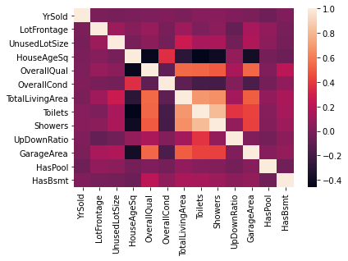
Feature Selection
Looked at correlation across metrics

Slide 13
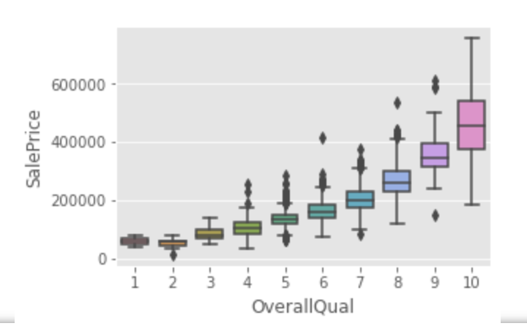
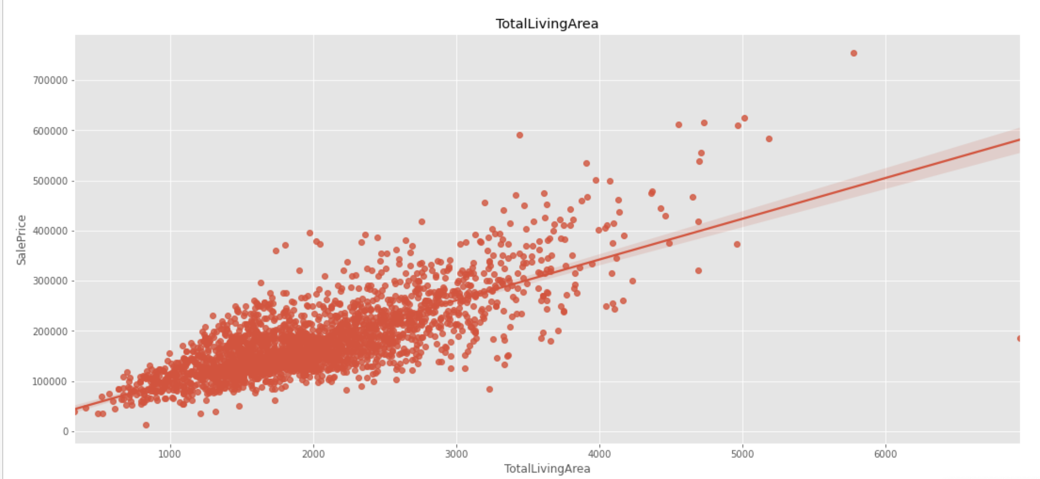
Feature Selection
Looked at different variables and how they correlated with sale price
Notes:
Overall quality and total living area used as an example

Slide 14
Model Variable Selection
Basement Quality
Building Type
Garage Area
Has Basement
Has Pool
House Age (Squared)
Lot Frontage
Neighborhood
Overall Condition
Overall Quality
Sale Condition
Showers
Toilets
Total Living Area
Unused Lot Size
Up/Down Ratio
Year Sold
These variables showed a strong correlation to the sale price on a house
and limited multi-collinearity.
Notes:
Variables chosen to be looked at further in model

Slide 15
Model Methodology

Slide 16
Regression Models Tested
Multiple Linear Regression with Lasso Regression
Random Forest
XGBoost
LightGBM
CatBoost
Support Vector Machine

Slide 17
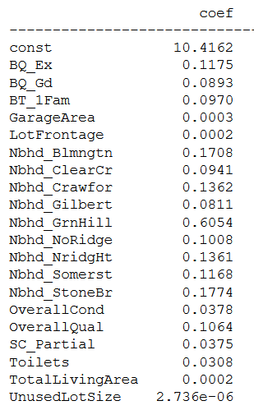
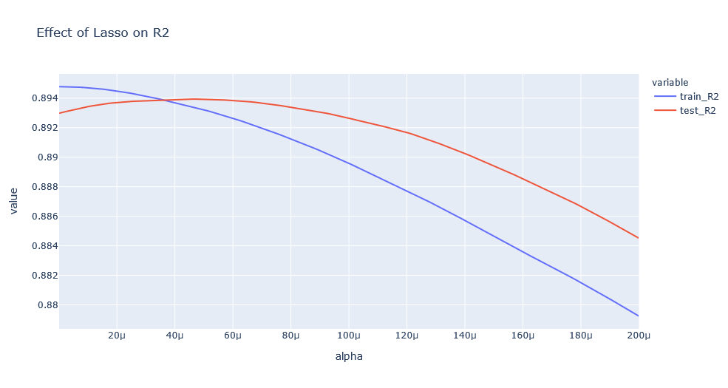
Multiple Linear Regression
Notes:
We started from our chosen variables and added the dummified categorical variables. We performed lasso regression. By using cross-validation and varying the alpha penalization rate, we found that the optimal rate where the test score maximized since that showed the best generalized model. From there, we culled the variables to those with non-zero coefficients.
Interpreting the results: Since our regression model predicts the log of the sale price, an increase in one unit of a given variable will increase the log SalePrice by the coefficient of the variable (keeping all other variables constant). For example, for an addition square foot of Total Living Area, we would expect the log price to increase by 2/100th of a cent.

Slide 18



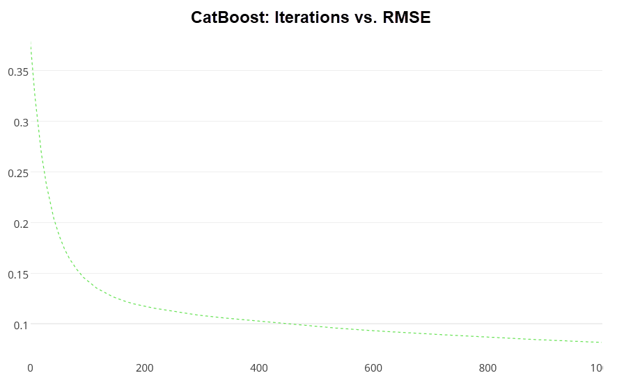
The Power of Boosting Models
CatBoost
XGBoost
LightGBM
Notes:
These high-performing tree-based models are variants on the boosting algorithm. These combine decision tree algorithms with boosting methods. The idea of boosting is to train weak learners sequentially, each trying to correct its predecessor.
Each took a significant period of time to cross-validate the hyperparameters. Training in general was slow; however, what it lacked in training speed, these models made up for in accuracy.
Depending on the model, different hyperparameters were tuned accordingly. Common among all of these were learning rate and maximum depth while CatBoost also offered a hyperparameter for L2 leaf regression. From our cross-validation, we learned that our best CatBoost model came from having a maximum depth of 7, an L2 Leaf Regularization parameter of 1, and a learning rate of 0.03.
CatBoost can handle categorical features natively inside the model. This allows for feature importances to be shown on the categorical features as a whole rather than breaking them up through One Hot Encoding.
https://towardsdatascience.com/catboost-vs-light-gbm-vs-xgboost-5f93620723db

Slide 19
Cross-Model Comparison
Model | Training R² | Testing R² | Best RMSE
CatBoost | 94.65% | 91.62% | 0.113
LightGBM | 97.40% | 91.00% | 0.117
XGBoost | 99.35% | 90.89% | 0.118
Random Forest | 97.86% | 89.66% | 0.126
Support Vector Machine | 90.38% | 88.30% | 0.134
Linear Regression | 87.00% | 88.24% | 0.138
Notes:
Here we can see the best root mean squared error for the log(SalePrice) per model. Since we have one statistic that is common among all the models, we can use it to compare them. The boosted models performed best, followed by another tree-based model (Random Forest). Then came Support Vector Machines and trailing all was linear regression.
Note the overfitting of the boosting models, but the performance still exceeds the others.

Slide 20
Modeling Lessons Learned
Boosting models perform well but take long to train (especially with CV)
Linear regression performs poorly when you have many features compared to other models
While the models are not in complete agreement, some variables always show high importance

Slide 21
Results & Conclusion

Slide 22
Conclusion
Most successful model:
CatBoost Model
Final Performance:
R²: 91.6%,
Root mean squared error: 0.1135

Slide 23
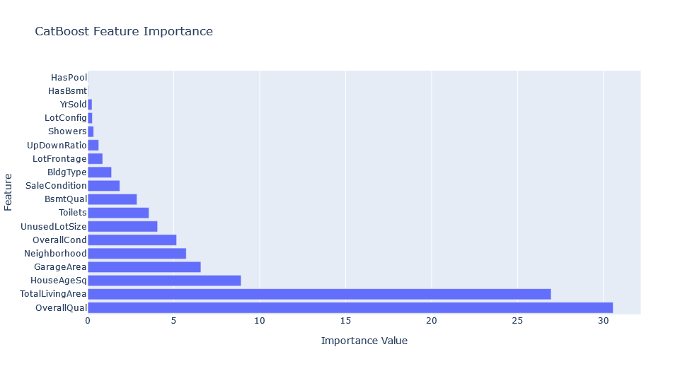
Feature Importances from CatBoost
Feature | Importance
Overall Quality (OverallQual) | 31%
Total Living Area (TotalLivingArea) | 27%
House Age Squared (HouseAgeSq) | 9%
Garage Area (GarageArea) | 7%
Neighborhood (Neighborhood) | 6%
Overall Condition (OverallCond) | 5%
Unused Lot Size (UnusedLotSize) | 4%
# of Toilets (Toilets) | 4%
Basement Quality (BsmtQual) | 3%
Sale Condition (SaleCondition) | 2%
Building Type (BldgType) | 1%
Lot Frontage (LotFrontage) | 1%
Upstairs/Downstairs Ratio (UpDownRatio) | 1%
Notes:
One outstanding feature of boosted models is their ability to capture the importance of different features in the modeling process. From the graph, we can see that the most important features are Overall Quality,Total Living Area, House Age Squared.

Slide 24
Next Steps
Compare offering prices to what the model predicts to find bargains

Slide 25
Next steps
Compare offering prices to what the model predicts to find bargains
Sale Price: $280,000
4 bedrooms
2 full baths + 2 half baths
2,241 sqft
Our estimate: $324,000
-10%
0%
+10%
+15.7%

Slide 26
Thank you

